Slide 1
Cal
Date
Echo
Printf
Bc/xcalc
Who
Whoami
Uname
tty
Ctrl-h
Ctrl-c or delete
Ctrl-d
Ctrl-s
Ctrl-u
!! (executes previous command)
exit

Slide 2
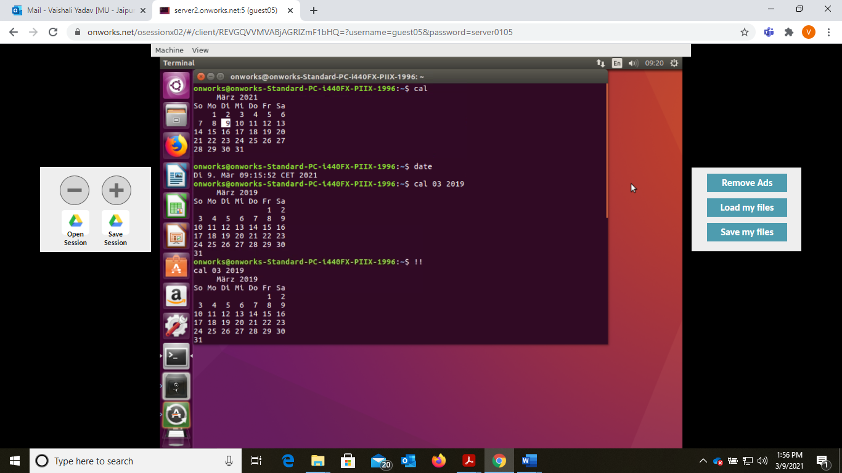

Slide 3
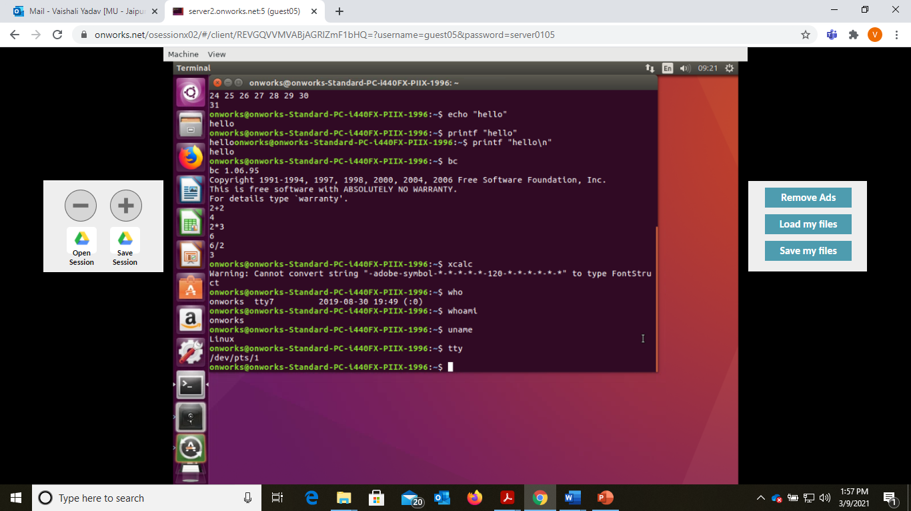

Slide 4
